Slide 1
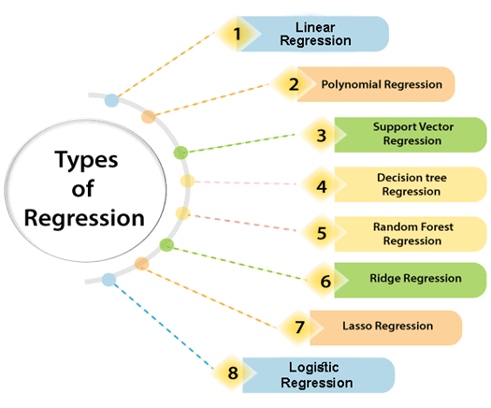

Slide 2
WHAT IS LINEAR REGRESSION?
In statistics, linear regression is a linear approach to modelling the relationship between a scalar response and one or more explanatory variables. The case of one explanatory variable is called simple linear regression; for more than one, the process is called multiple linear regression.
The representation is a linear equation that combines a specific set of input values (x) the solution to which is the predicted output for that set of input values (y). As such, both the input values (x) and the output value are numeric.

Slide 3
TYPES OF LINEAR REGRESSION
SIMPLE LINEAR REGRESSION
MULTIPLE LINEAR REGRESSION

Slide 4
SIMPLE LINER REGRESSION
Simple linear regression is a regression model that estimates the relationship between one independent variable and one dependent variable using a straight line. Both variables should be quantitative.
ŷᵢ = β₀ + β₁Xᵢ
y hat sub i (ŷᵢ) represents the estimated output given the input. (Xᵢ)
In this equation, β₀ is a bias and β₁ is the weight of the model. If the model is charted so that the output is the y axis and the input is the x axis, β₀ refers to the y - intercept and β₁ represents the slope.

Slide 5
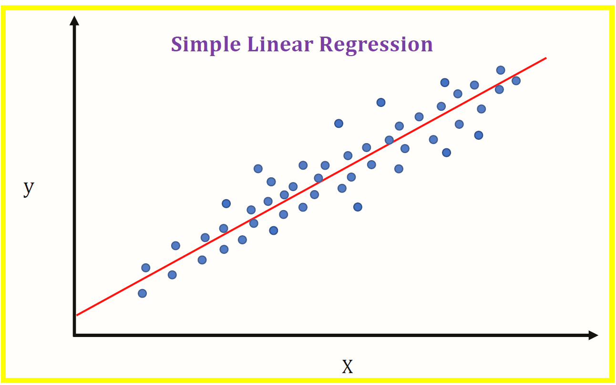
SIMPLE LINEAR REGRESSION

Slide 6
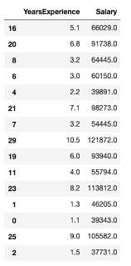
EXAMPLE OF SIMPLE LINEAR REGRESSION

Slide 7
MULTIPLE LINEAR REGRESSION
Multiple linear regression is really similar to simple linear regression. However, it maps the relationship between multiple types of inputs and an output.
An estimate of the relationship can be given as:
ŷᵢ = β₀ + β₁Xᵢ₁ + β₂Xᵢ₂ + … βnXn
* n represents subscript n
y hat sub i (ŷᵢ) represents the estimated output given the input. (Xᵢ)
β₀ is a bias and β₁, … βn are the weights of the model.
Xᵢ₁, … Xᵢn represents all of the individual input datapoints where Xᵢ₁ represents a singular datapoint of input type X₁.
n is the number of input data types

Slide 8
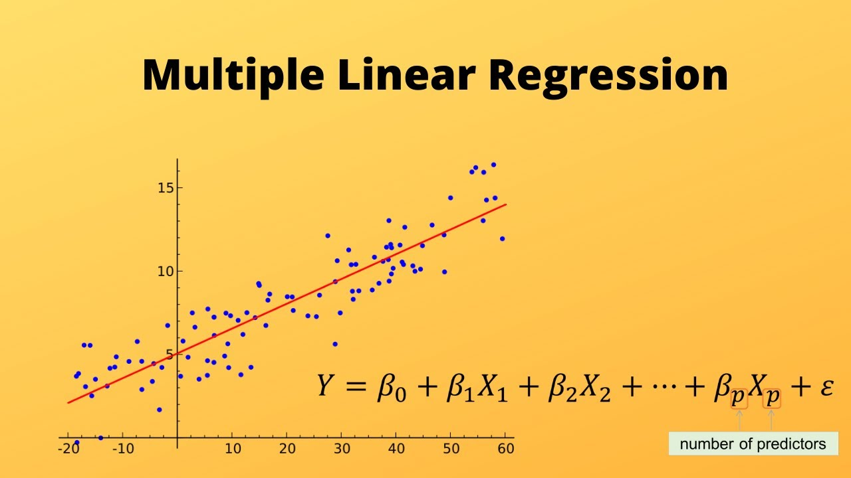
MULTIPLE LINEAR REGRESSION

Slide 9
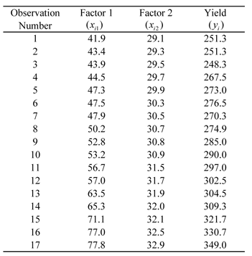
EXAMPLE OF MULTIPLE LINEAR REGRESSION

